Slide 1
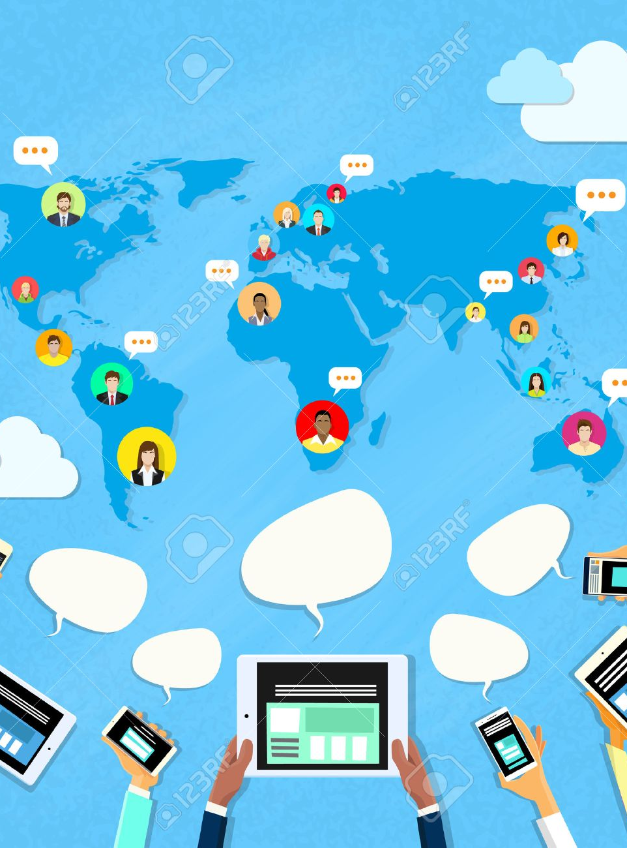
WebSocket to Support Web-base, Full-duplex Event Broadcast and Intensive Interaction
IVAN Zheng

Slide 2

The Why, What and How
1
Why’s online meeting keep breaking?
2
<http/> vs <WebSocket/>
3
a new way of “PPT sharing”
4
How does it work
5
business opportunities
6
What’s Next()=>{}

Slide 3
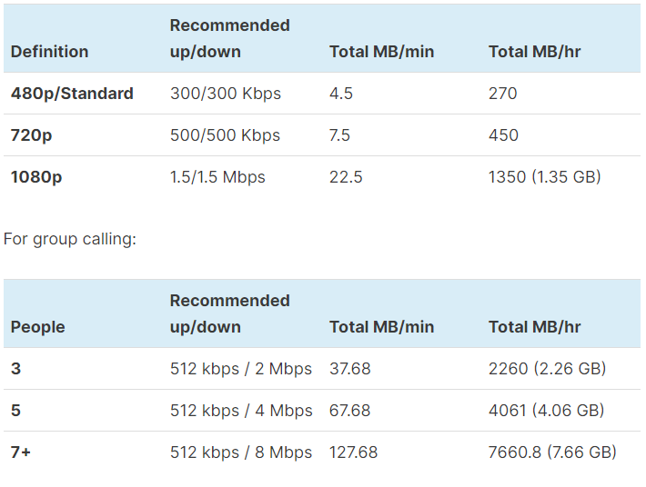
Traditional Online Meeting Systems
Skype’s bandwidth usage
Like “Skype, Zoom, MS Teams, Zoom, etc.”, what do they have in common?
Need specific software
Audience need account to join
Heavy Network Traffic
The more the attendees, the more it cost, the worse the performance.

Slide 4
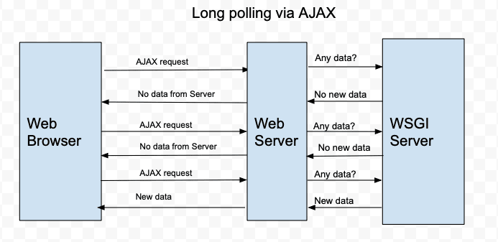
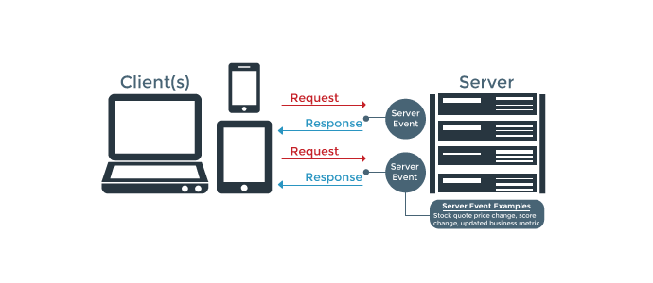
How could our webApp support 2-ways’ communication
Web applications use Comet/Ajax, AJax Long polling and HTML5 Server Sent Events (SSE) to do this over HTTP.
With long polling via AJAX, the server keeps polling WSGI server to check any new data.
HTTP is not meant for keeping the connection open for the server to send frequent data to a client.
Here comes the WebSocket protocol

Slide 5
WebSockets is event-driven: both the server, and the client can react to events and messages. We can listen for a connection event, fire up a function when a new user connects to the server, emit a message (basically an event) over a socket, and much more.

Slide 6
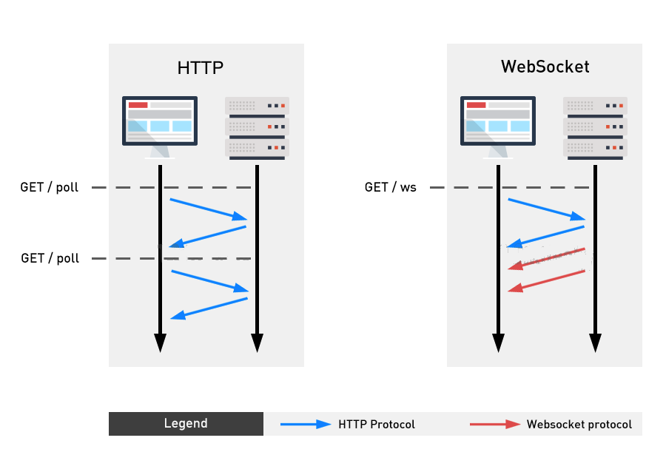
<HTTTP/>
<WebSocket/>
The most common protocol dominate the internet.
Every http-request makes a connection and closes it after the response.
Http is equipped with lot of headers to actually reach it's destination over the internet.
Except the typical initial handshake in http, the rest of communication is headerless and lightweight.
Bi-directional, Full-duplex connection allows client and server push frames from either side.
Client and server to communicate in more real-time.

Slide 7
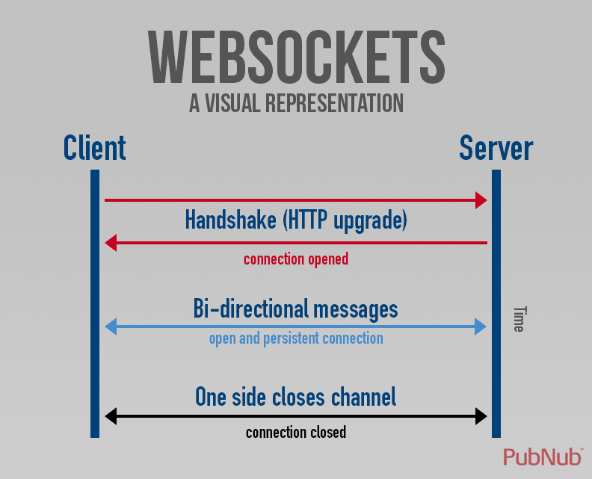
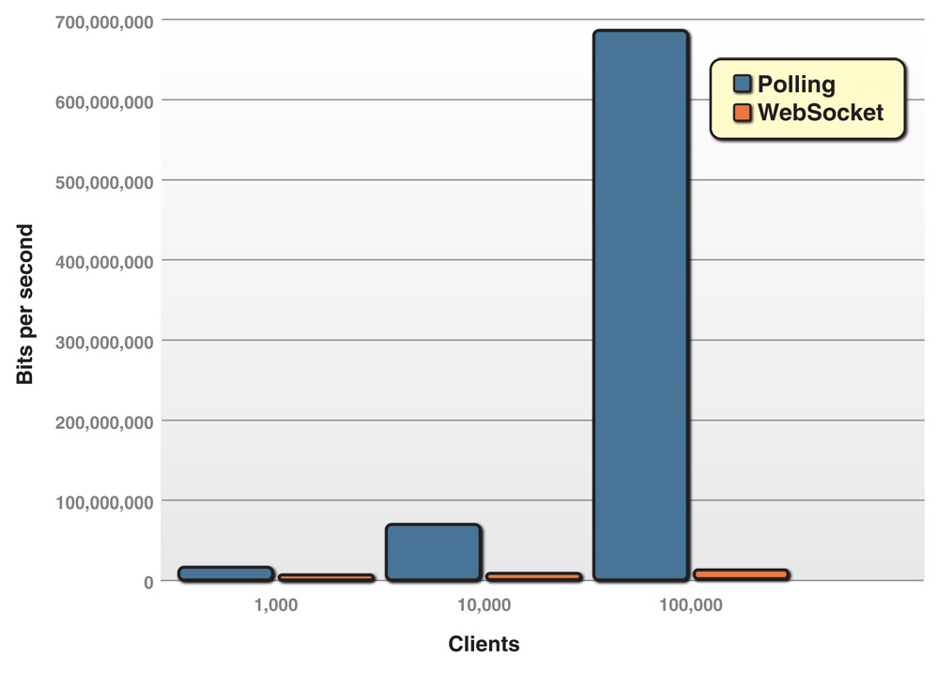
<Polling /> VS <WebSocket>
Dramatic reduction in unnecessary network traffic that is obtained for the polling solution with 1,000, 10,000, and 100,000 concurrently connected clients and compares it to WebSocket way.

Slide 8
Introduce a new way of “PPT sharing” kind of conference

Slide 9

A full-duplex web-app to share information and enable massive interaction

Slide 10
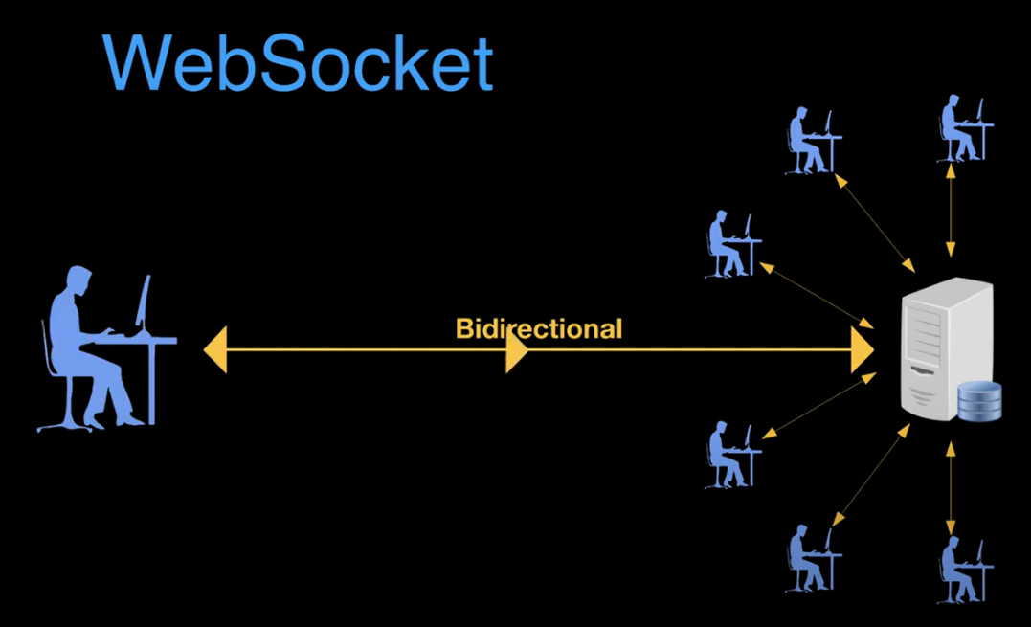
The magics - We are all the audience as well as the broadcaster
Login to the App as a viewer, the content appear as normal information website
When you are empowered as the “host”, your Key operation on the App will be emitted to all other clients
All client Apps will react instantly as the emitted message indicates
The clients may participate in the interactional widgets, which’s result will be reflected in all participants.

Slide 11
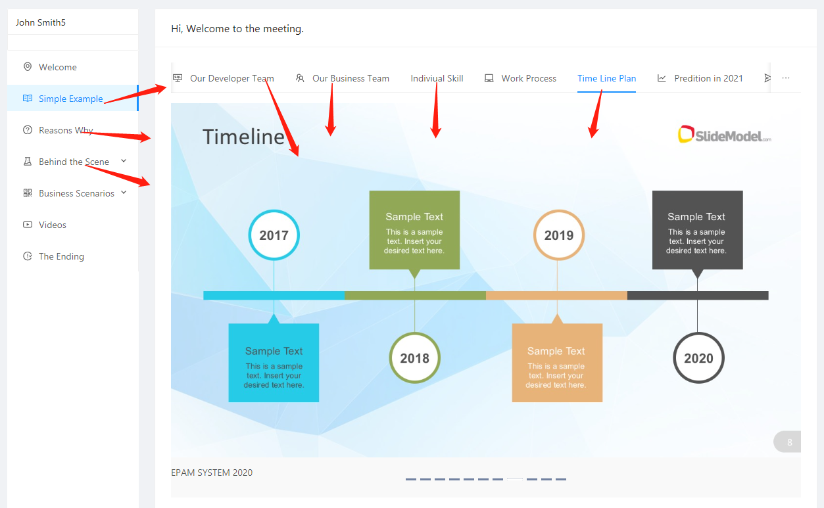

Slide 12
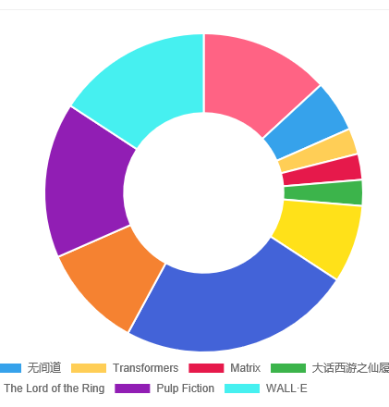
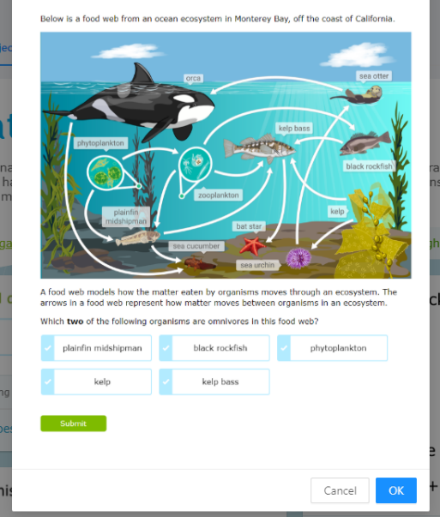
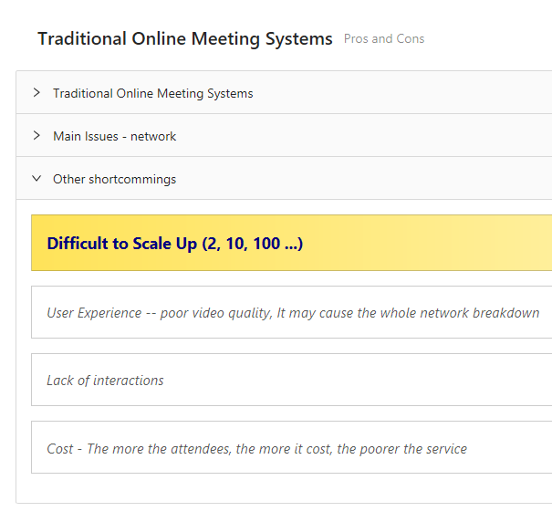
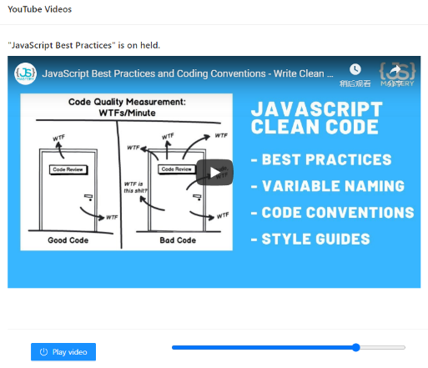
highlight
Voting
Popup quiz
Play video

Slide 13
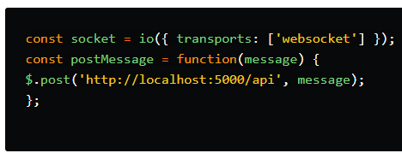

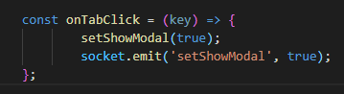
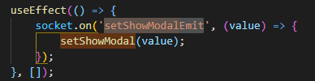
How does it work – Client side
The front-end to connect to the server
The front-end to emit a message/action
The front-end act upon the message is received
https://socket.io/docs/client-api/

Slide 14
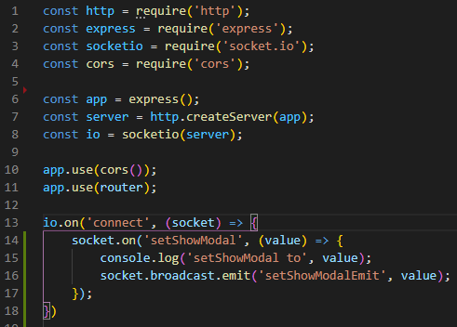

The server side – nodejs
Import the packages and start the connect
And listen to the “setShowModal” event
And broadcast it to all others.

Slide 15
business opportunities

Slide 16
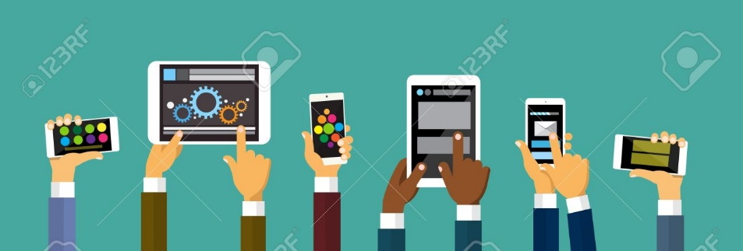
Two-ways interaction
Client dominate
Synchronous Web Broadcast
PPT-like shareing,
Online Education,
Online Bidding/Selling,
A theme party (Annual party,Wedding)
As a Remote Control (Public LED, Smart TV, Vending Machine, Food Ordering )
As a Synchronous Information system, It can support up to 1M users for some on-going events
Television, Concerts, Movice
Press Conference, Tour Guide Service,
Sport Events/Olympics

Slide 17
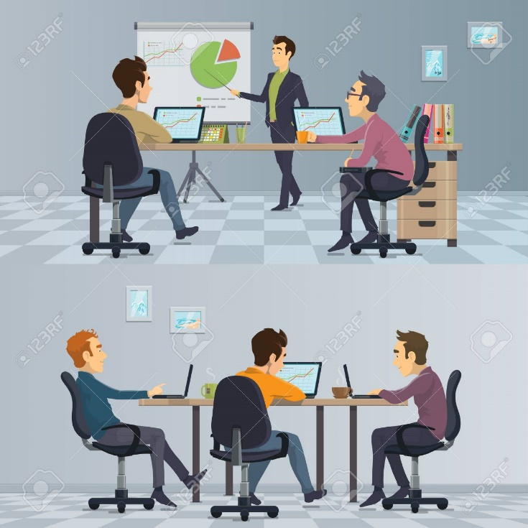
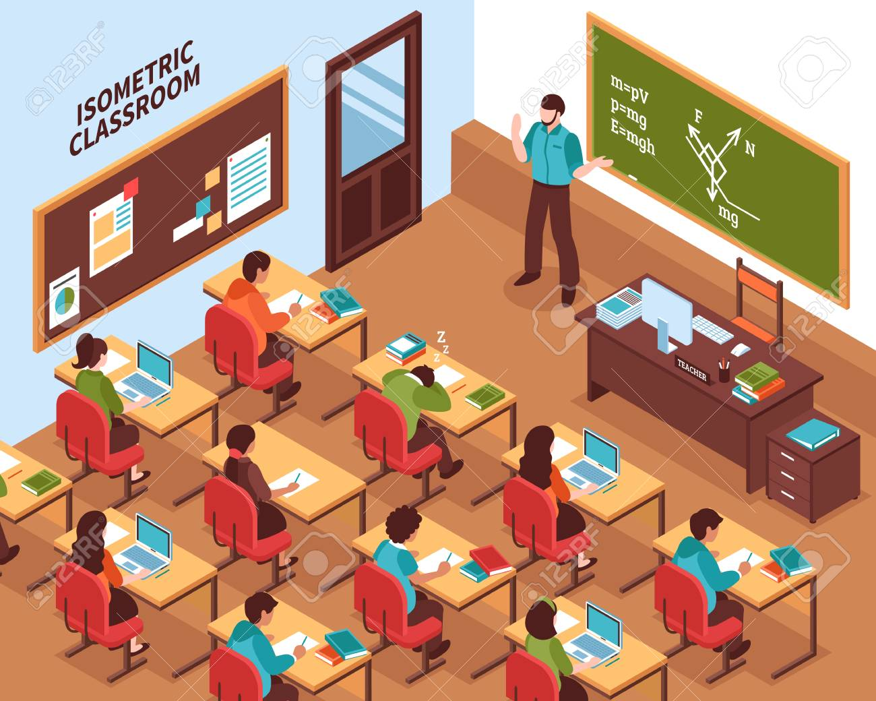
Full-duplex information interaction
Conference content sharing
Educational assistant
Replacement for blackboards, text-books, sliders
High involvement education

Slide 18
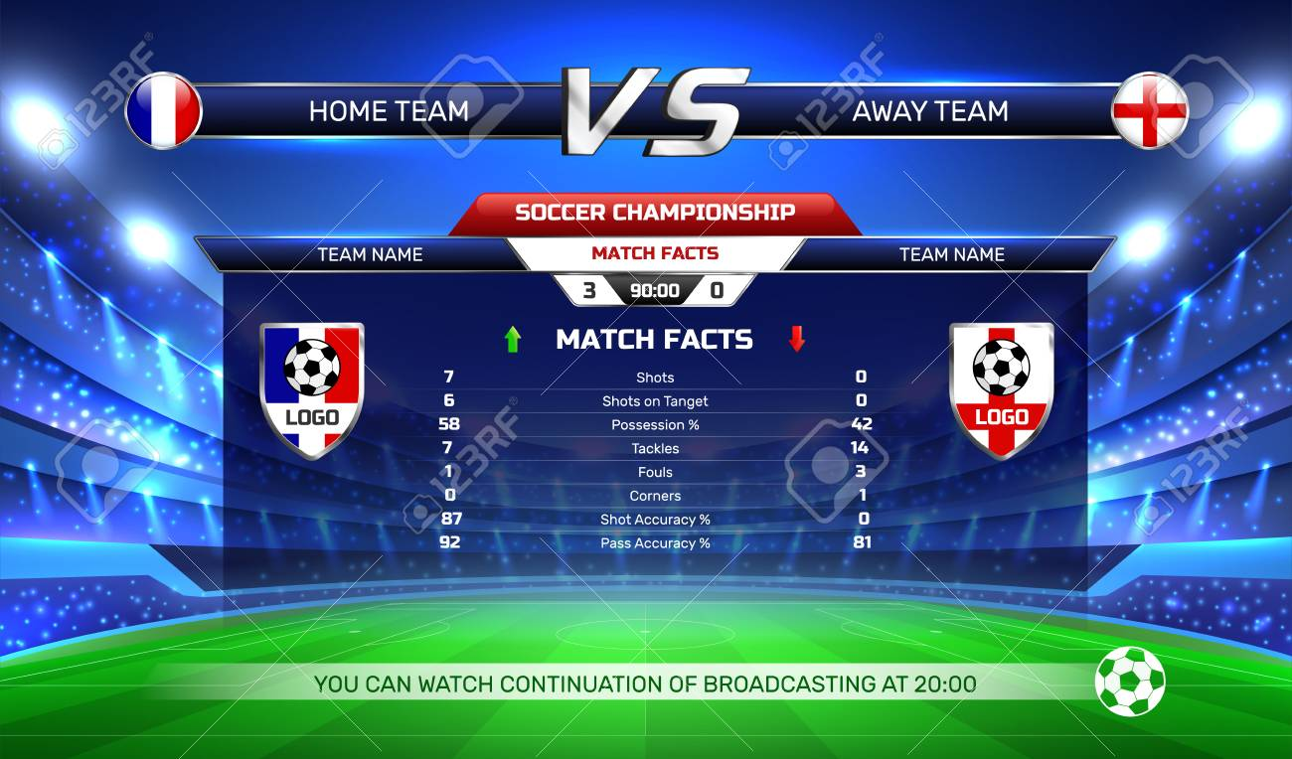
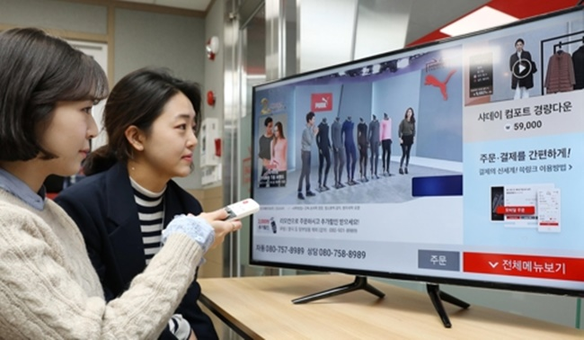
Light-weight web broadcasting synchronized with the show/event
Television synchronous broadcast
Sport event synchronous broadcast
The WebApp keep broadcasting related information synchronized with what’s on the TV channel
Whenever there is an advertisements, the audiences can learn more about it on his/her phone and purchase it in one click.

Slide 19
What’s Next()=>{}

Slide 20
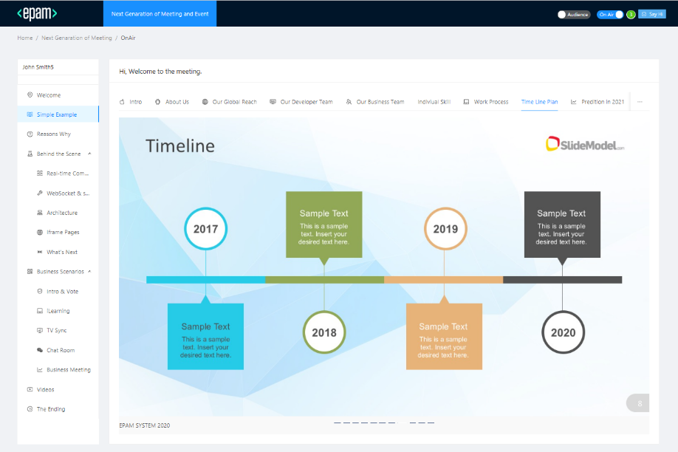
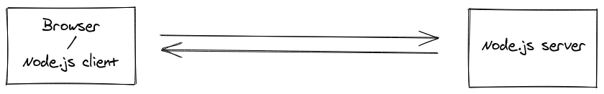
A WebApp POC is built ➔ Front-end: ReactJs, Socket.io, Antd Back-end: NodeJs+ socket.io

Slide 21
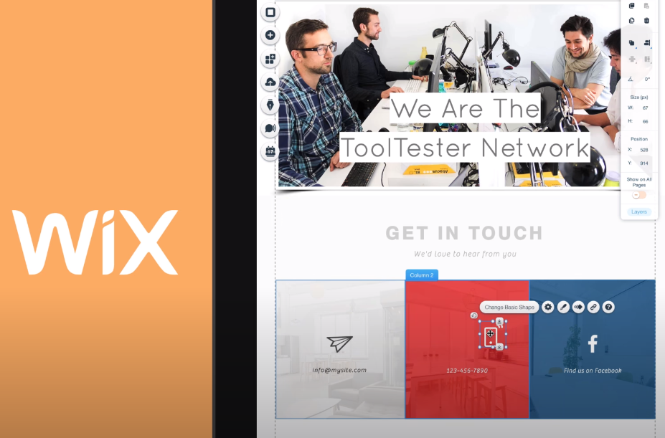
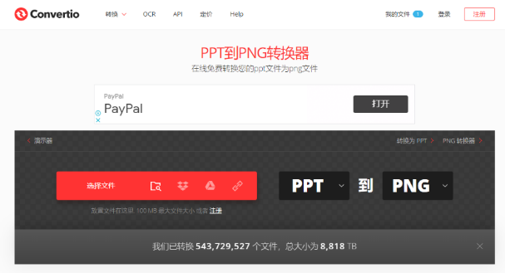
How to generate content of your own?
Provide content templates
Web-base content composer, provide lots of template likes Wix.com, WordPress.org, for the user to generate their own App easily.
Online PPT → HTML/JPG functions

Slide 22

Links
WebSockets Tutorial
https://ant.design/
https://socket.io/
WebSocket vs. Long polling HTTP
socket.io 概述
socket.io 原理分析
HTML5 WebSocket: A Quantum Leap in Scalability for the Web

Slide 23
Thank you!

